Slide 1
Processor Micro-program
Presented By:
Shaykh Siddique
Arif Hasan Nayon
Md. Shohag
Department of Computer Science and Engineering,
East West University.

Slide 2
Overview
Introduction
Problem Definition
Objective
Design and Implementation
Micro-programmed control unit
Architecture
Implementation
Result
Pseudocode
How does it works (simulation)
Conclusions

Slide 3
Problem
Using micro-program as instructions directly:
No instruction set.
No program counter(PC), using micro-program counter.
Operation with register.
Example instruction: ADD R0, R1, R2.

Slide 4
Objective
The control signals associated with operations are stored in special memory units inaccessible by the programmer as Control Words.
Control signals are generated by a program are similar to machine language programs.
Micro-program will fetch instructions with micro-program counter and makes the operations like addition.

Slide 5
Objective
Control unit design approaches-
Micro-programmed implementation
Hardwired logic implementation
Micro-Programmed Implementation:
The control signal values for each micro-operation are stored in a memory(Registers).
- Reading the contents of the control store in a prescribed order is equivalent to sequencing through the micro-operations

Slide 6
Objective
Hardwired logic implementation:
The Control Unit is viewed and designed as a combinatorial and sequential logic circuit.
The Control Unit is implemented by using any of a variety of “standard” digital logic techniques. The logic circuit generate the fixed sequences of control signals

Slide 7
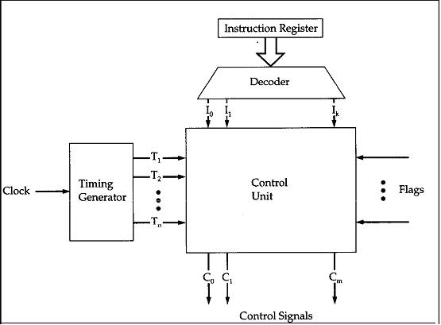
Micro-programmed control unit
As Simulation criteria we can assume that, Instruction from Instruction Register will decoded and comes in control unit.
Instruction- ADD R1, R2, R3 will Considered as additional operation will held.
Here, C₀, C_{1,} … , C_{n} these are the control signals.
ADD will generate a control signal which will related to addition.

Slide 8
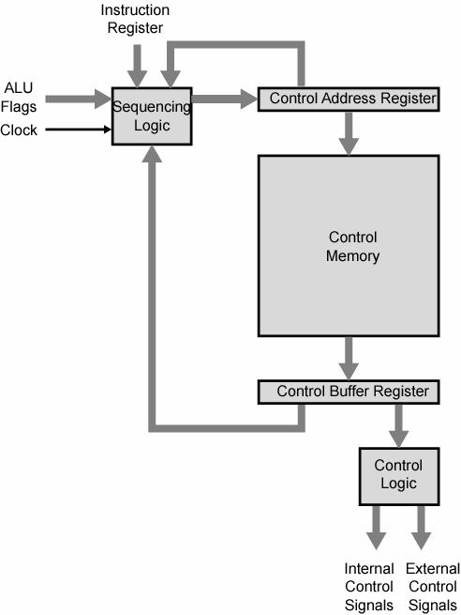
Micro-instruction Execution
Control address register will generate the address of registers.
From the control memory the value of registers will came to Control Buffer Register which will generate control logic.
A sequence of micro-instructions is called a micro-program, which is stored in a ROM or RAM called a Control Memory.

Slide 9
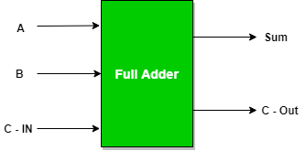
Design
ADD R0, R1, R2
R1-(A)
Register
R0(C_{out})
Register
+
R2-(B)
Register
Used four bit binary full adder for the addition.

Slide 10
Implementation and Simulation
module full_adder4(A, B, Cin, Sum, Cout);
input [3:0] A,B; // four-bit inputs
input Cin; // one-input input carry
output [3:0] Sum; // five-bit outputs
output Cout;
wire [2:0] carry;
// internal carry wires
adder fa0(A[0],B[0],Cin,Sum[0],carry[0]);
adder fa1(A[1],B[1],carry[0],Sum[1],carry[1]);
adder fa2(A[2],B[2],carry[1],Sum[2],carry[2]);
adder fa3(A[3],B[3],carry[2],Sum[3],Cout);
endmodule
module adder(a, b, cin, s, cout);
input a, b, cin;
output s, cout;
assign s = a ^ b ^ cin;
assign cout = (a & b) | (cin & a) | (cin & b);
endmodule

Slide 11
Test Bench Program
For testing the micro-program, giving the input values in register, we used a test bench program.
The value of two registers A and B are defined here.
initial begin
// Initialize Inputs
A = 0; B = 0; Cin = 0;
#5 A = 4'b0001; B = 4'b0001;
#5 A = 4'b0001; B = 4'b0010;
#5 A = 4'b0011; B = 4'b0101;
#5 A = 4'b0100; B = 4'b0110;
#5 A = 4'b0101; B = 4'b0110;
#5 A = 4'b0110; B = 4'b0111;
#5 A = 4'b0111; B = 4'b1000;
#10 $stop;
end

Slide 12
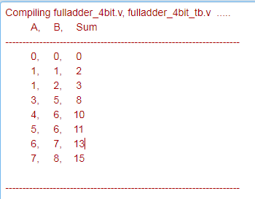
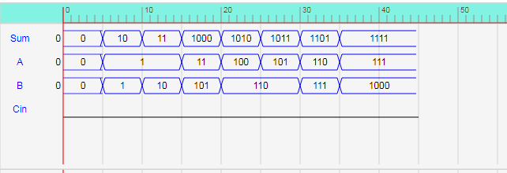
Output Evaluation
Relational waves for input and output values.

Slide 13
Performance
Tested Verilog Compiler:
ModelSim from Mentor Graphics
ISim from Xilinx ISE
And Quartus 2
We used ModelSim from Mentor Graphics For simulation

Slide 14
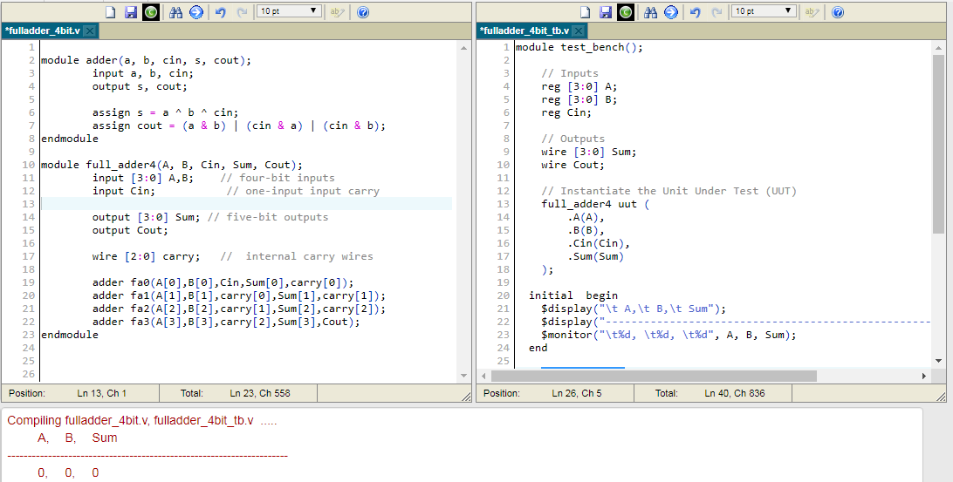
Performance

Slide 15
Conclusion
The advantage to this approach is significant saving in control memory size (bits).
Disadvantage is more complexity and slower operation (doing 2 memory accesses for each microinstruction).
Micro-programmed control unit is slower in speed because of the time it takes to fetch microinstructions from the control memory.
On this case Hardwired control is faster than micro-programmed control.
A controller that uses this approach can operate at high speed as our software is a simulation software.
It requires no additional hardware(decoders). And it is more flexible and reusable then Hardwired control system.

Slide 16
Conclusion
For the typically large microprocessor systems today:
There are many instructions and associated register level hardware.
There are many control point to be manipulated.
The use of a micro-program on one machine to execute programs originally written to run on another machine.
By changing the microcode of a machine, you can make it execute software from another machine.

Slide 17
Thank You

